Slide 1

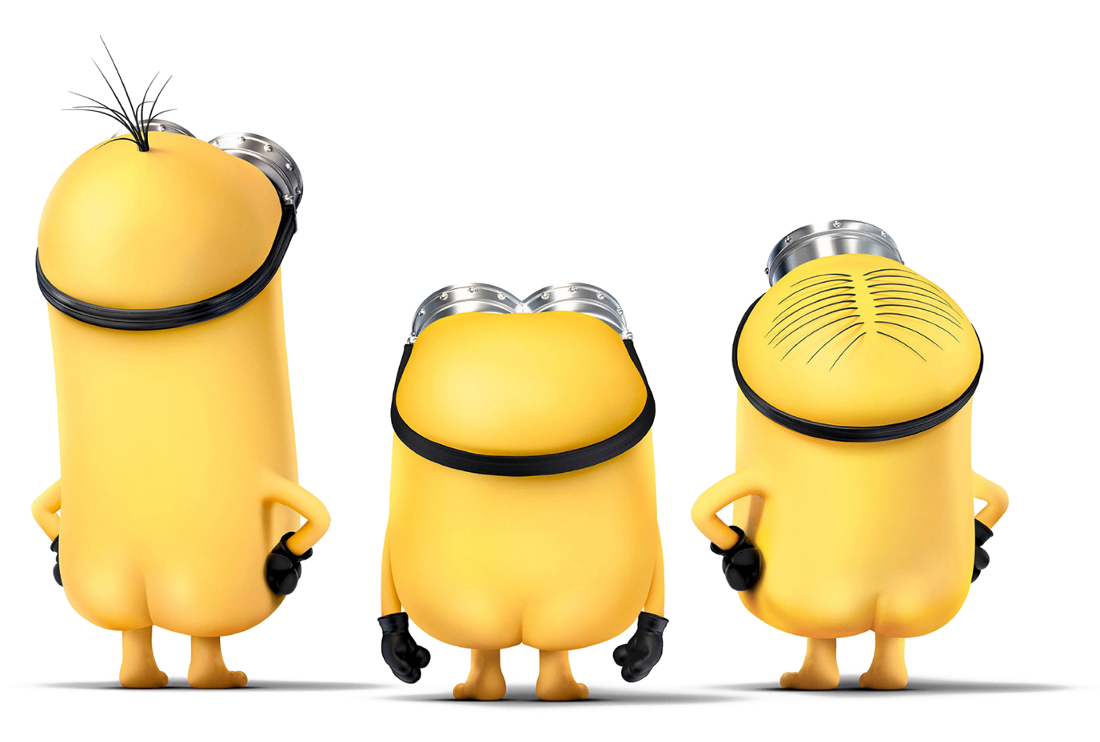
BELLO
LUOJIA DESIGN
(HELLO)

Slide 2
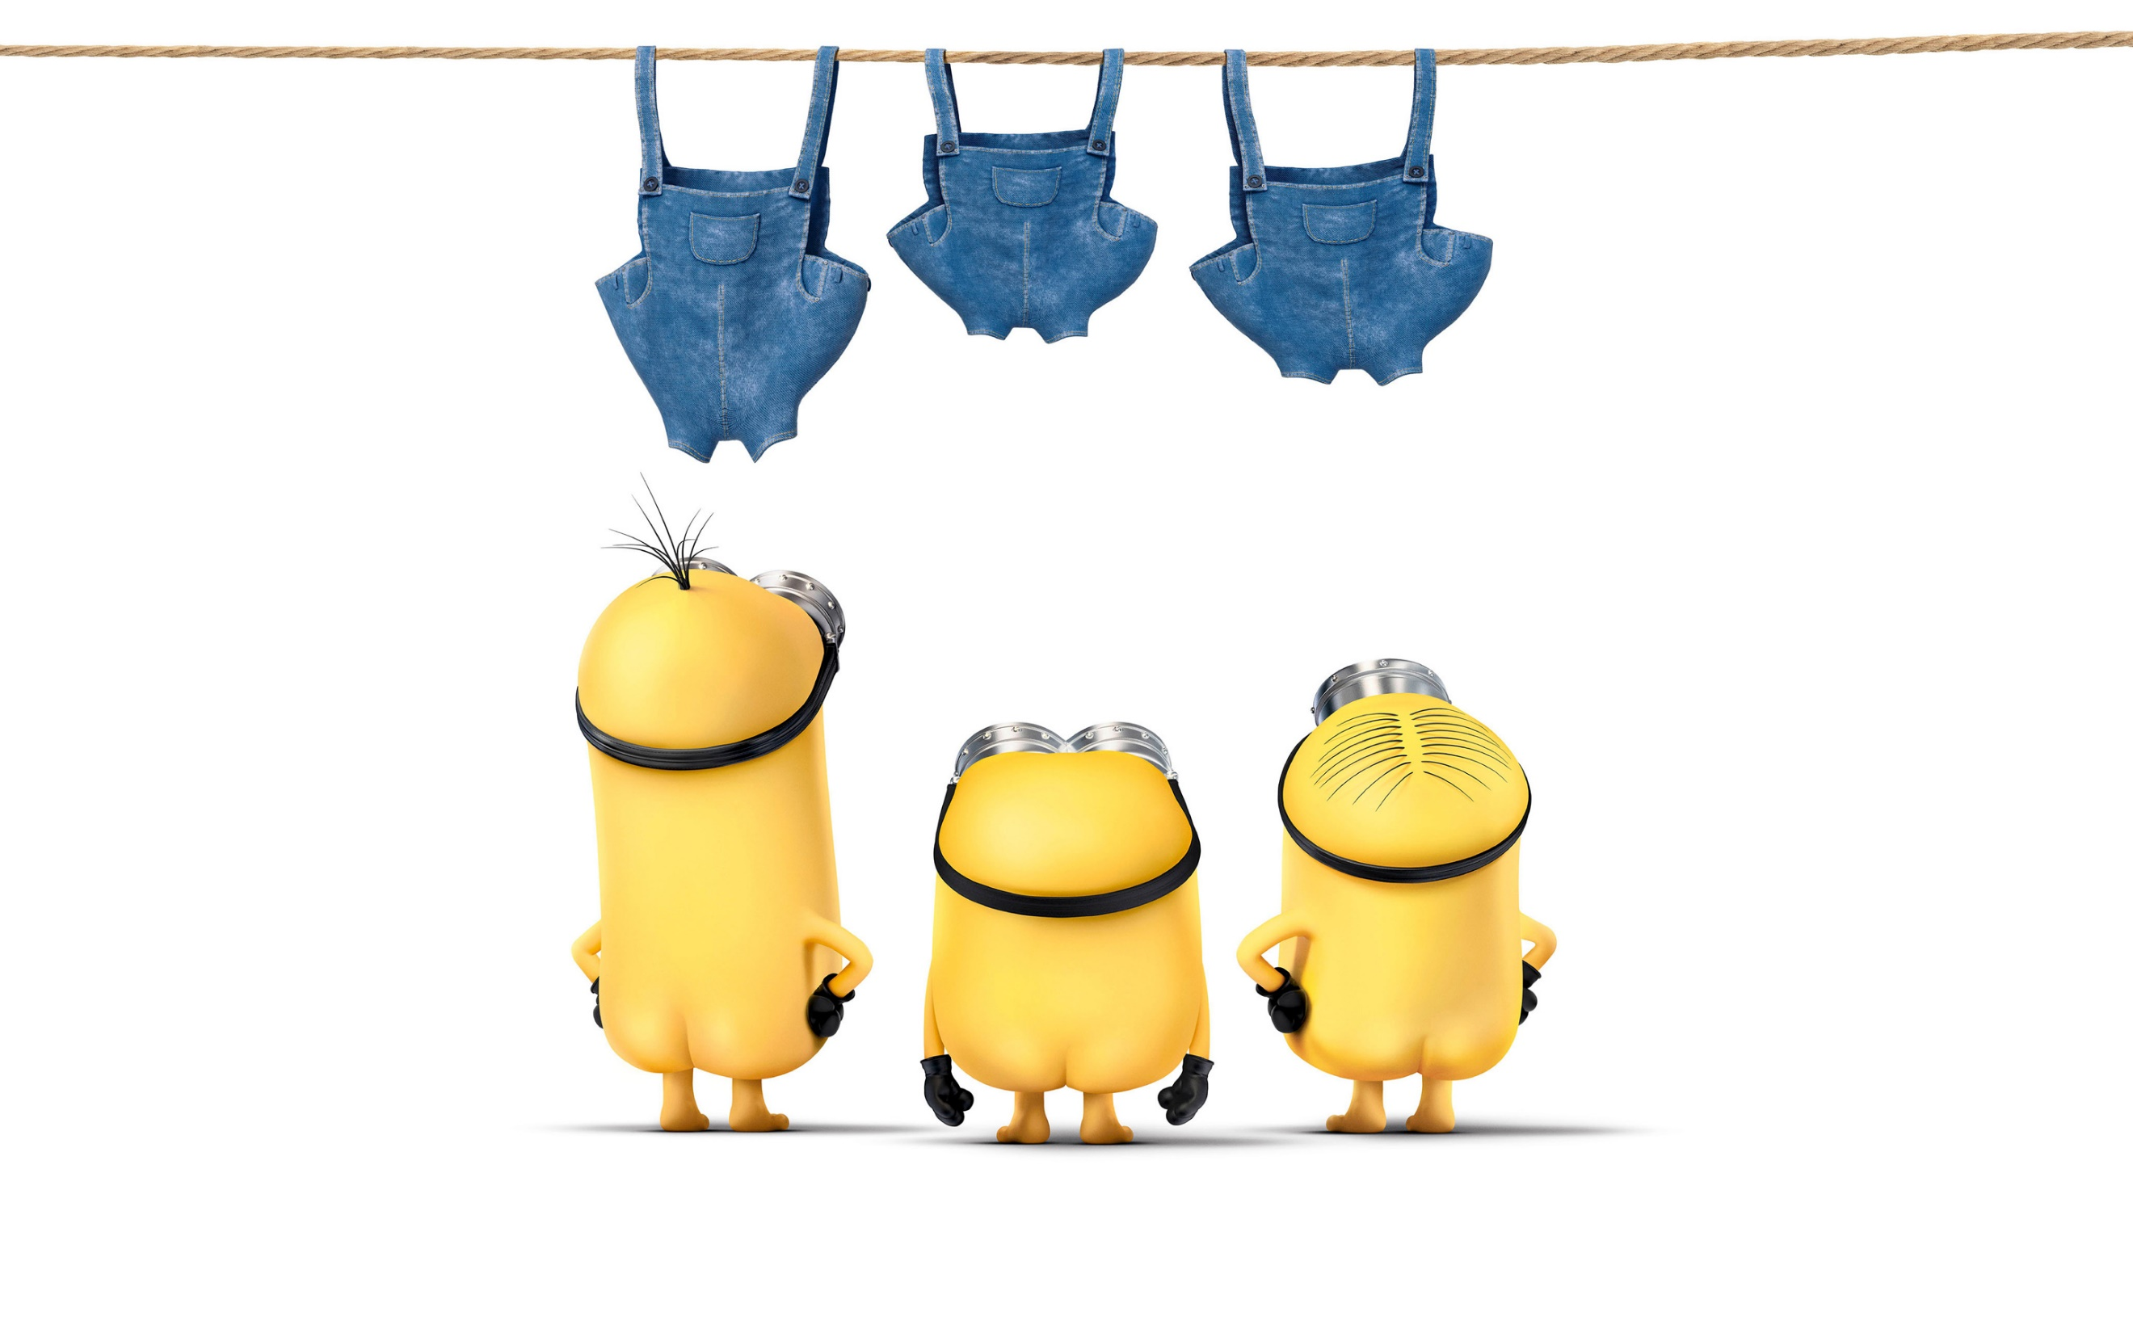
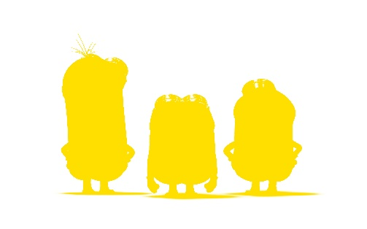
PART SEVEN
PART SIX
LUOJIAPPT DESIGN
PART FIVE
LUOJIAPPT DESIGN
06
PART FOUR
05
LUOJIAPPT DESIGN
PART TWO
LUOJIAPPT DESIGN
04
03
PART ONE
LUOJIAPPT DESIGN
LUOJIAPPT DESIGN
02
01
CONTENTS
minions Stuart, Kevin and Bob are recruited by Scarlet Overkill, a super-villain who, alongside her inventor husband Herb, hatches a plot to take over the world.

Slide 3

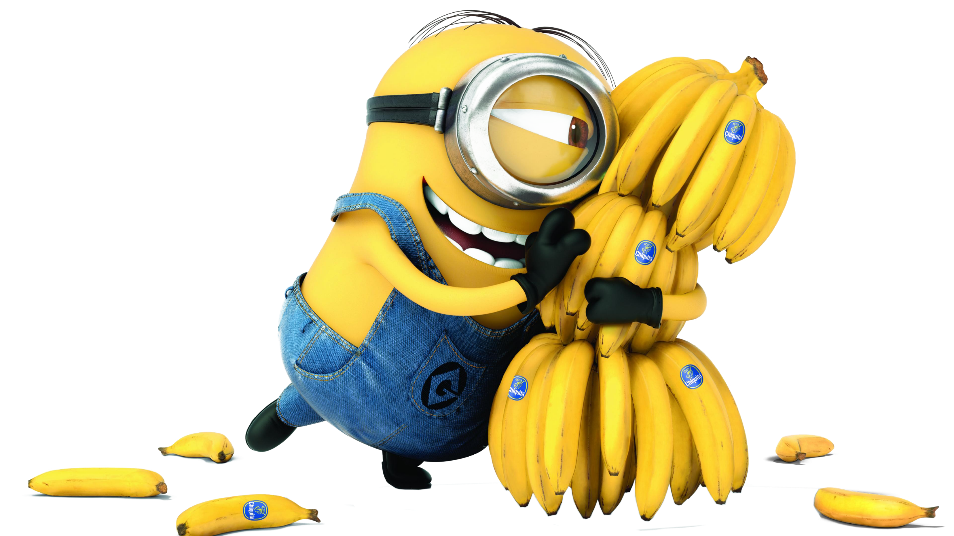
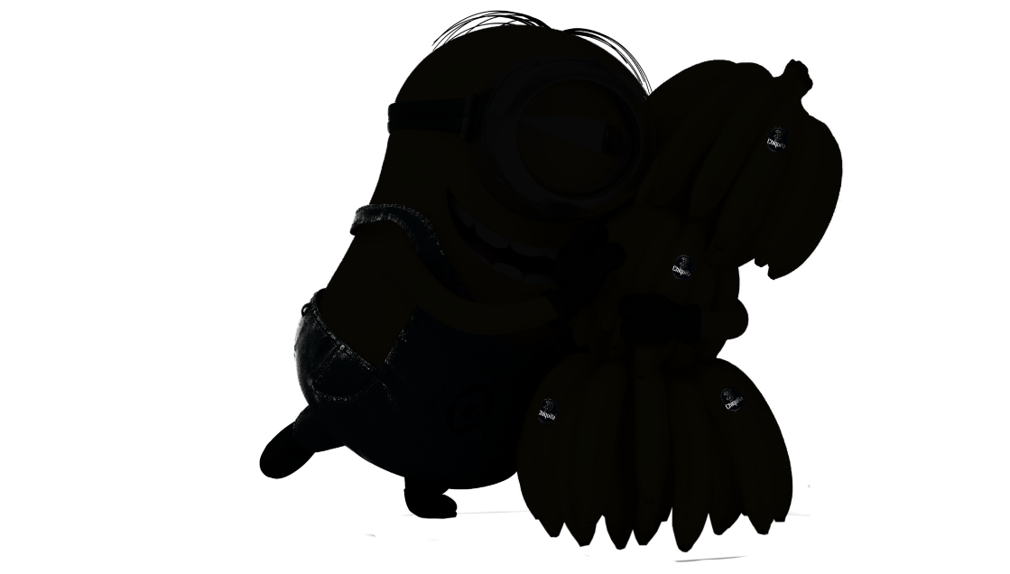
PART 01
MINIONS STUART, Kevin and Bob are recruited by Scarlett Overkill, a super-villain who, alongside her inventor husband Herb, hatches a plot to take over the world.
Minions Stuart, Kevin and Bob are recruited by Scarlett Overkill, a super-villain who, alongside her inventor husband Herb, hatches a plot to take over the world.

Slide 4
TITLE HERE
minions Stuart, Kevin and Bob are recruited by Scarlet Overkill, a super-villain who, alongside her inventor husband Herb, hatches a plot to take over the world.

Slide 5

KEVIN
MINIONS STUART, Kevin and Bob are recruited by Scarlett Overkill, a super-villain who, alongside her inventor husband Herb, hatches a plot to take over the world.
MINIONS STUART, Kevin and Bob are recruited by Scarlett Overkill, a super-villain who, alongside her inventor husband Herb, hatches a plot to take over the world.
MINIONS
Kevin and Bob are recruited by Scarlett Overkill, a super-villain who, alongside her inventor husband Herb, hatches a plot to take over the world.

Slide 6
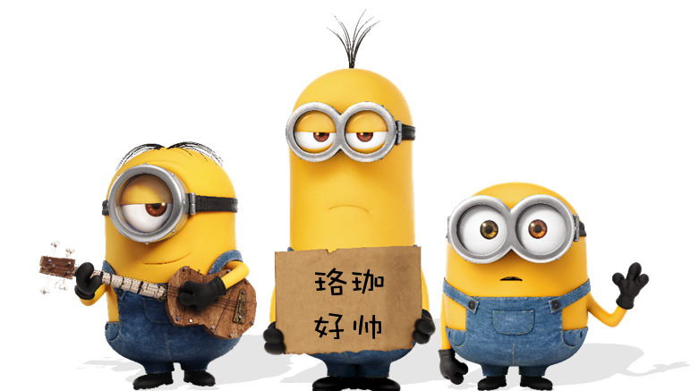
LINE
Minions Stuart, Kevin And Bob Are Recruited By Scarlett Overkill, A Super-villain Who, Alongside Her Inventor Husband Herb, Hatches A Plot To Take Over The World.
MINIONS
Kevin and Bob are recruited by Scarlett Overkill, a super-villain who, alongside her inventor husband Herb, hatches a plot to take over the world.

Slide 7
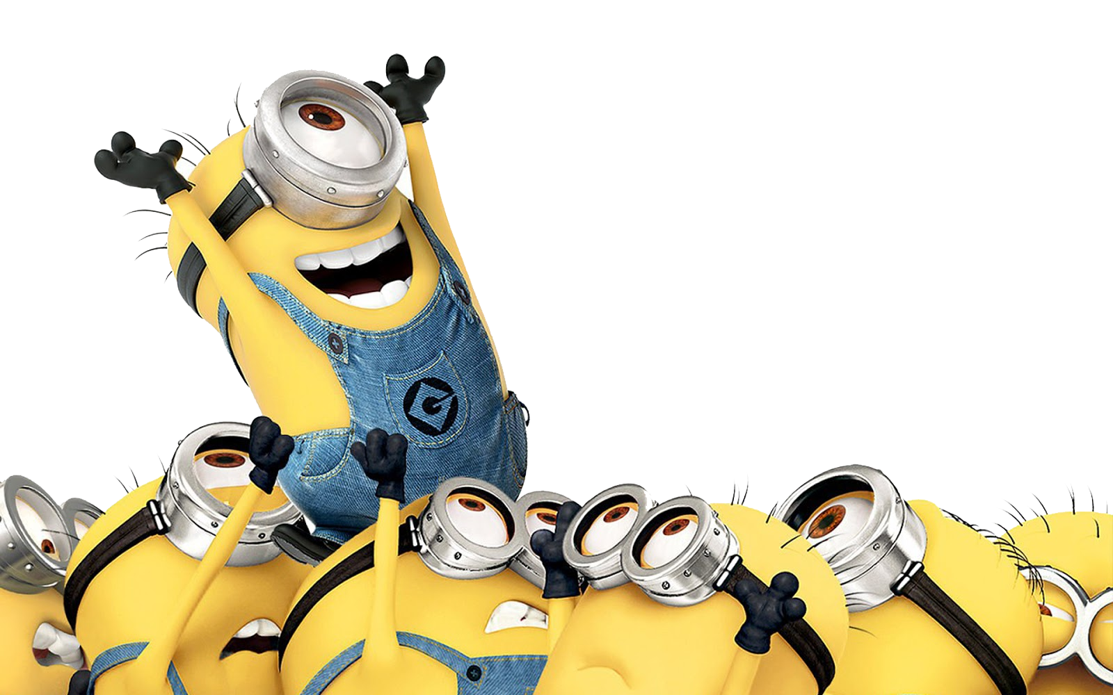
Kevin and Bob are recruited by Scarlett Overkill, a super-villain who, alongside her inventor husband Herb, hatches a plot to take over the world.
TITLE HERE
MINIONS
Kevin and Bob are recruited by Scarlett Overkill, a super-villain who, alongside her inventor husband Herb, hatches a plot to take over the world.

Slide 8
LOUISWITHOUTE
MINIONS
MINIZOMBIES
MINIONS STUART, KEVIN AND BOB ARE RECRUITED BY SCARLETT OVERKILL
MINIONS STUART, KEVIN AND BOB ARE RECRUITED BY SCARLETT OVERKILL

Slide 9
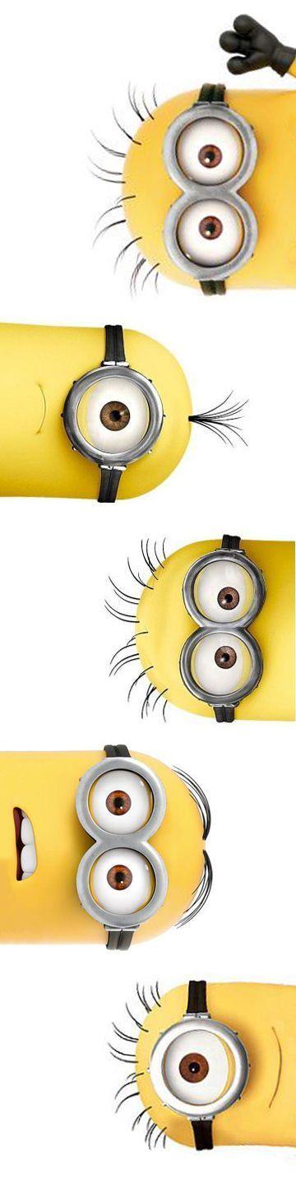
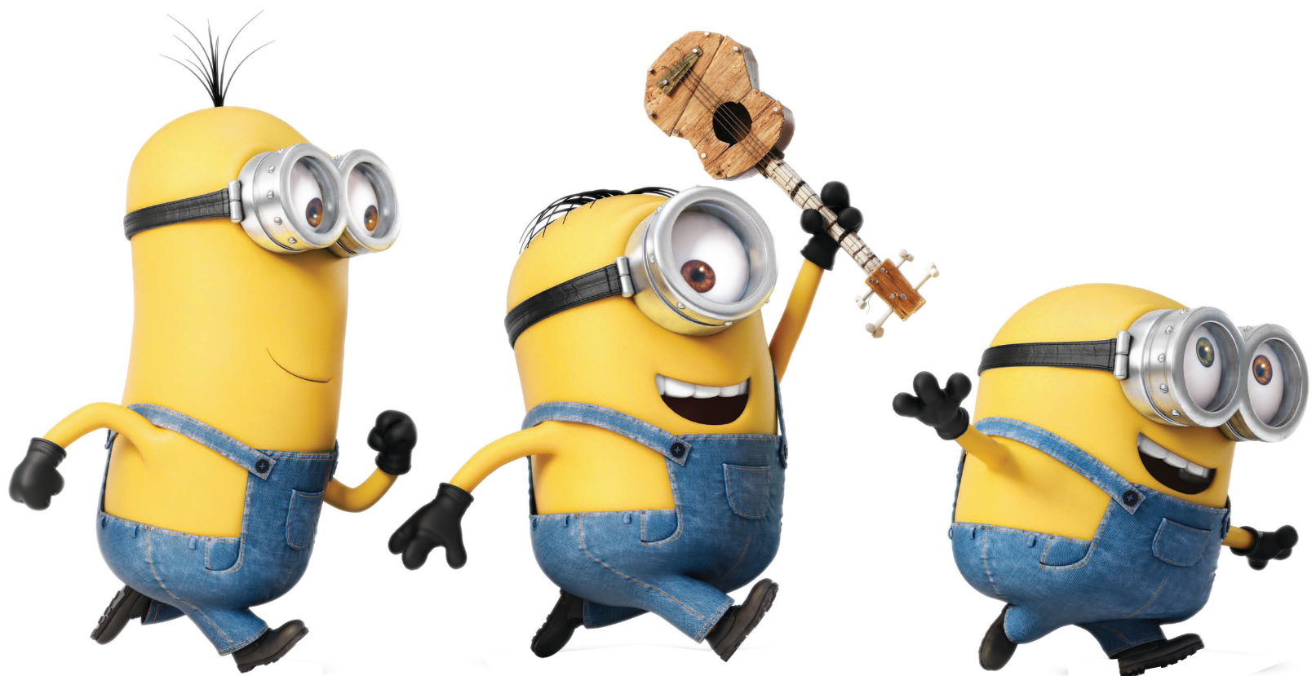
PART 02
Minions Stuart, Kevin and Bob are recruited by Scarlett Overkill, a super-villain who, alongside her inventor husband Herb, hatches a plot to take over the world.
PART 02
Minions Stuart, Kevin And Bob Are Recruited By Scarlett Overkill, A Super-villain Who, Alongside Her Inventor Husband Herb, Hatches A Plot To Take Over The World. Minions Stuart, Kevin And Bob Are Recruited By Scarlett Overkill, A Super-villain Who, Alongside Her Inventor Husband Herb, Hatches A Plot To Take Over The World.

Slide 10
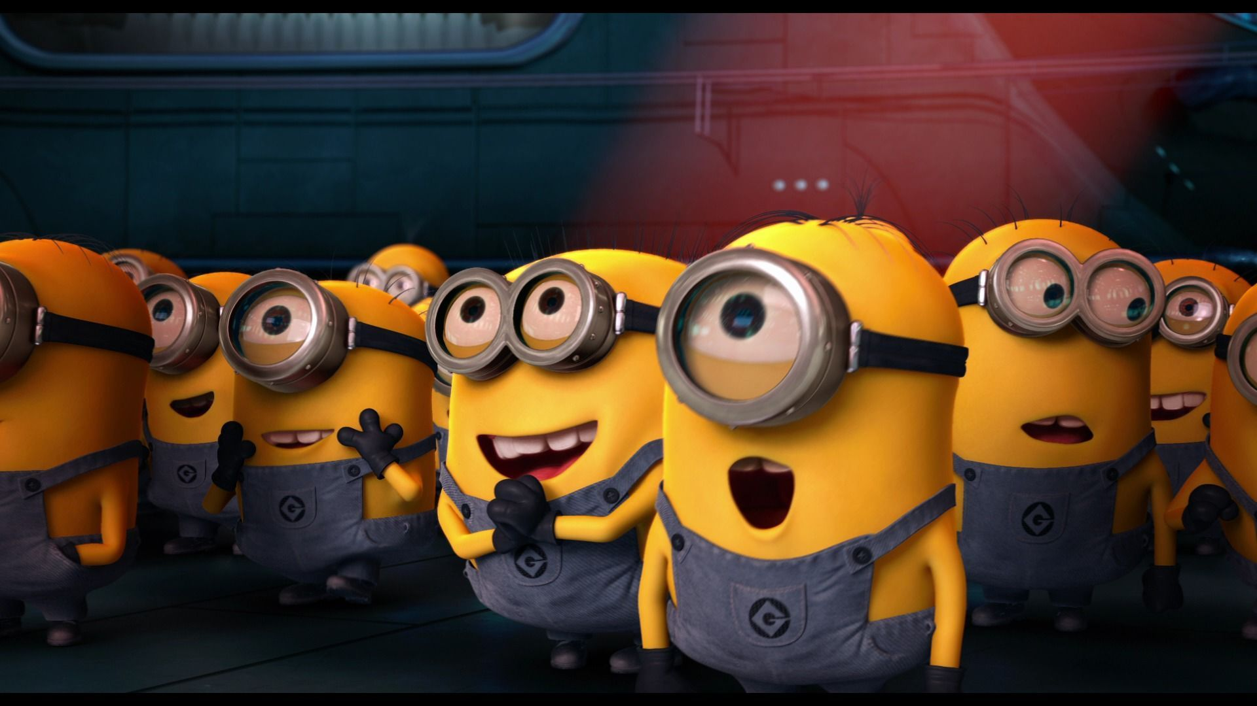
TADO!
Minions Stuart, Kevin and Bob are recruited by Scarlett Overkill, a super-villain who, alongside her inventor husband Herb, hatches a plot to take over the world.
Minions Stuart, Kevin and Bob are recruited by Scarlett Overkill, a super-villain who, alongside her inventor husband Herb, hatches a plot to take over the world.

Slide 11
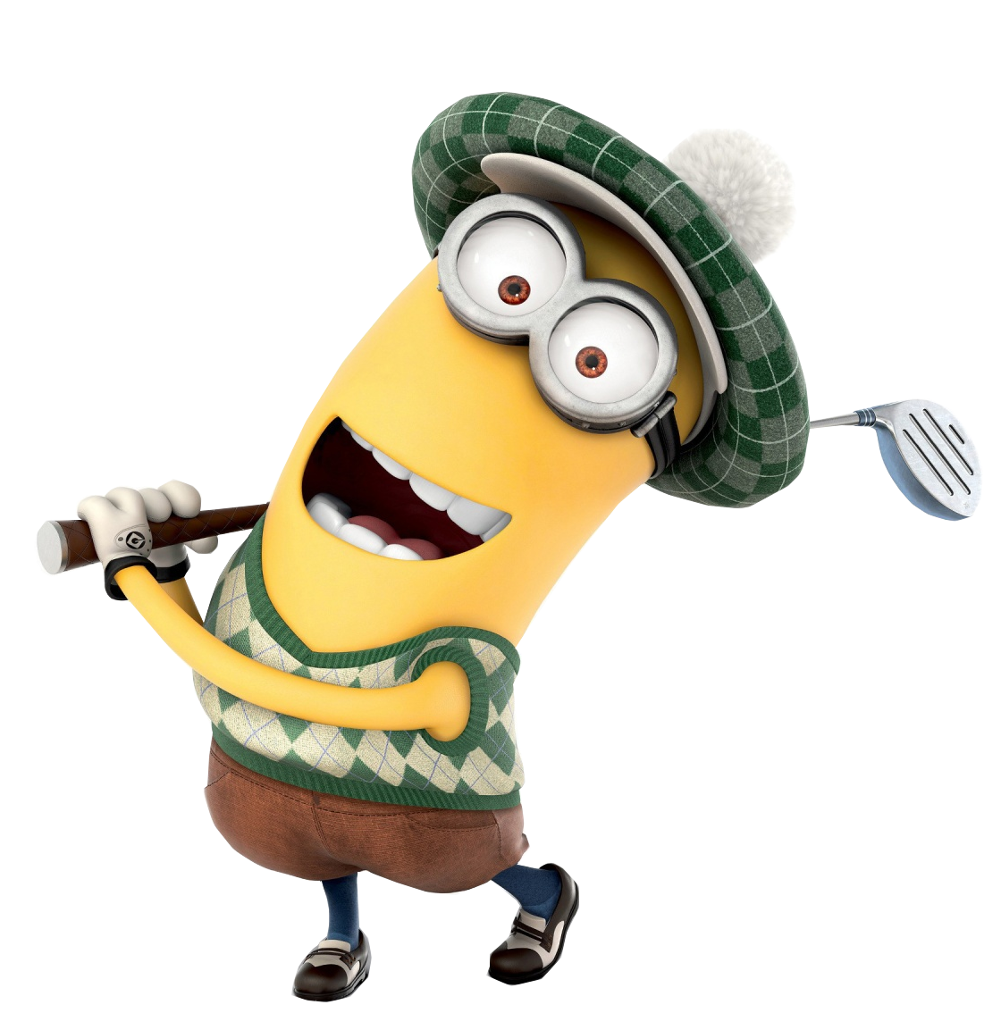
MINIONS
Kevin and Bob are recruited by Scarlett Overkill, a super-villain who, alongside her inventor husband Herb, hatches a plot to take over the world.
Kevin and Bob are recruited by Scarlett Overkill, a super-villain who, alongside her inventor husband Herb, hatches a plot to take over the world.
KEVIN AND BOB
are recruited by Scarlett Overkill
KEVIN AND BOB
are recruited by Scarlett Overkill

Slide 12

KEVIN
Kevin and Bob are recruited by Scarlett Overkill, a super-villain who, alongside her inventor husband Herb, hatches a plot to take over the world.
TWO
ONE
THREE
MINIONS STUART, KEVIN AND BOB ARE RECRUITED BY SCARLETT OVERKILL, A SUPER-VILLAIN WHO.

Slide 13
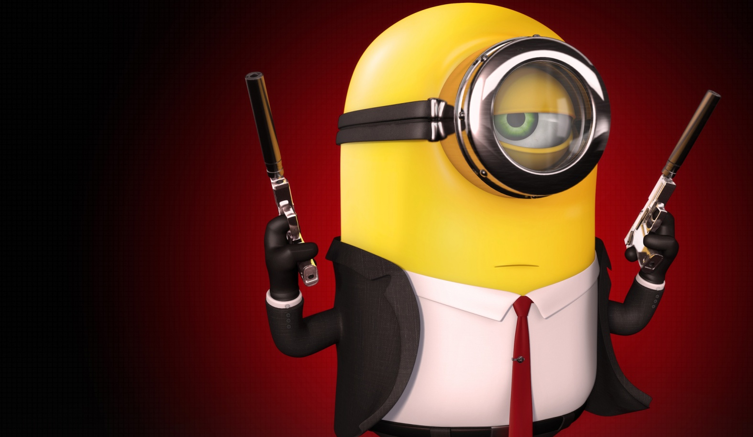
POOPAYE!
Minions Stuart, Kevin and Bob are recruited by Scarlett Overkill,
MINIONS
Kevin and Bob are recruited by Scarlett Overkill, a super-villain who, alongside her inventor husband Herb, hatches a plot to take over the world.

Slide 14
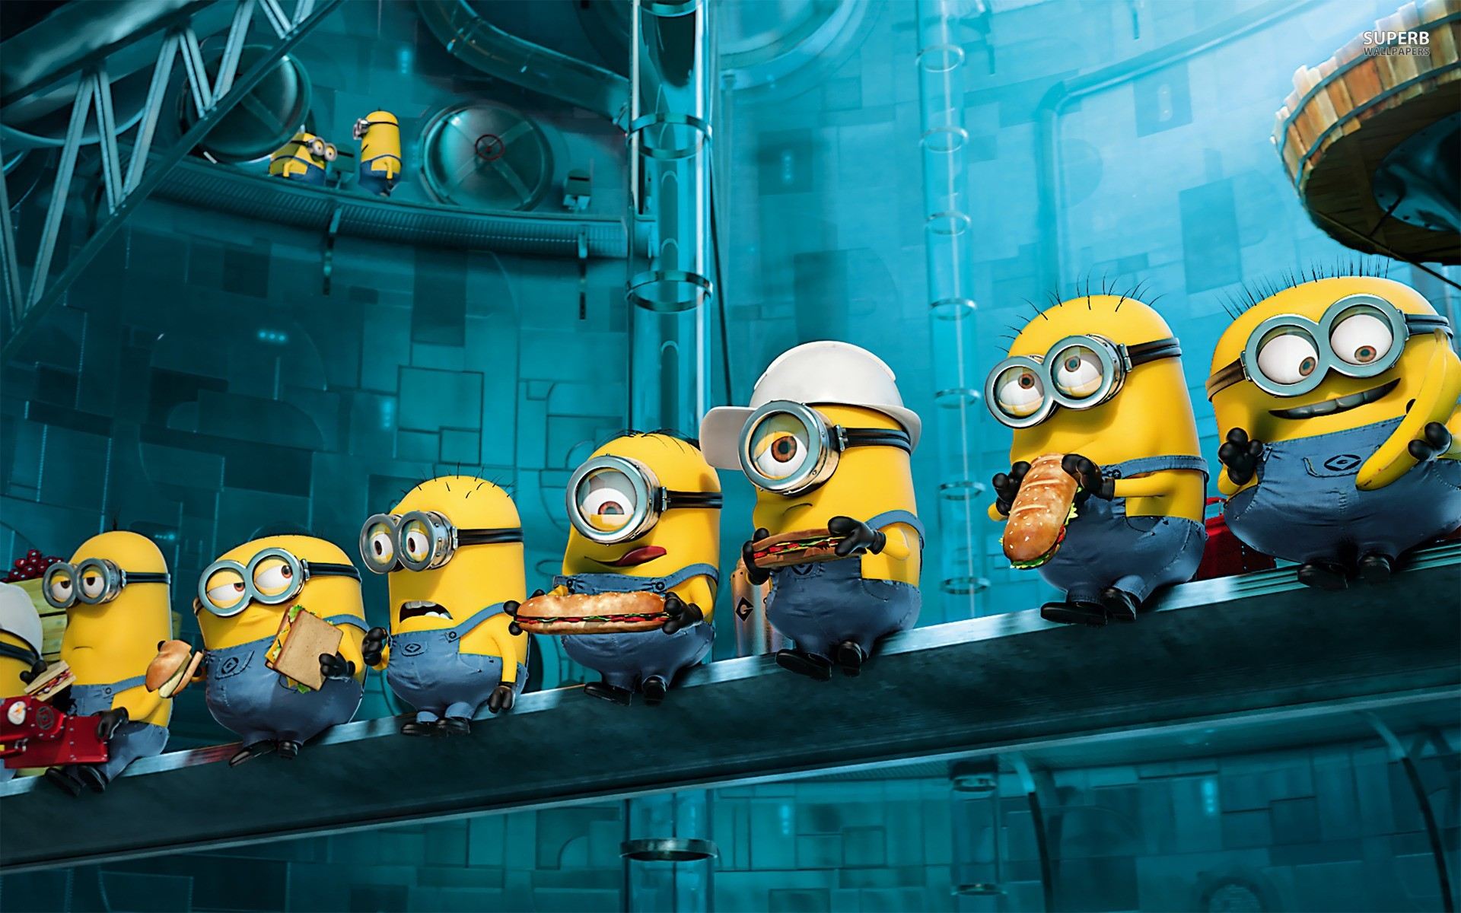
TITLE HERE
MINIONS
Kevin and Bob are recruited by Scarlett Overkill, a super-villain who, alongside her inventor husband Herb, hatches a plot to take over the world.

Slide 15

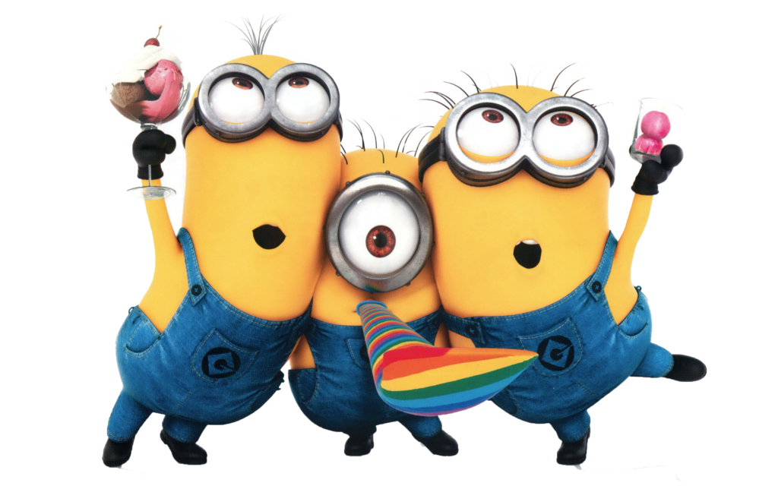
TITLE HERE
MINIONS
Kevin and Bob are recruited by Scarlett Overkill, a super-villain who, alongside her inventor husband Herb, hatches a plot to take over the world.

Slide 16
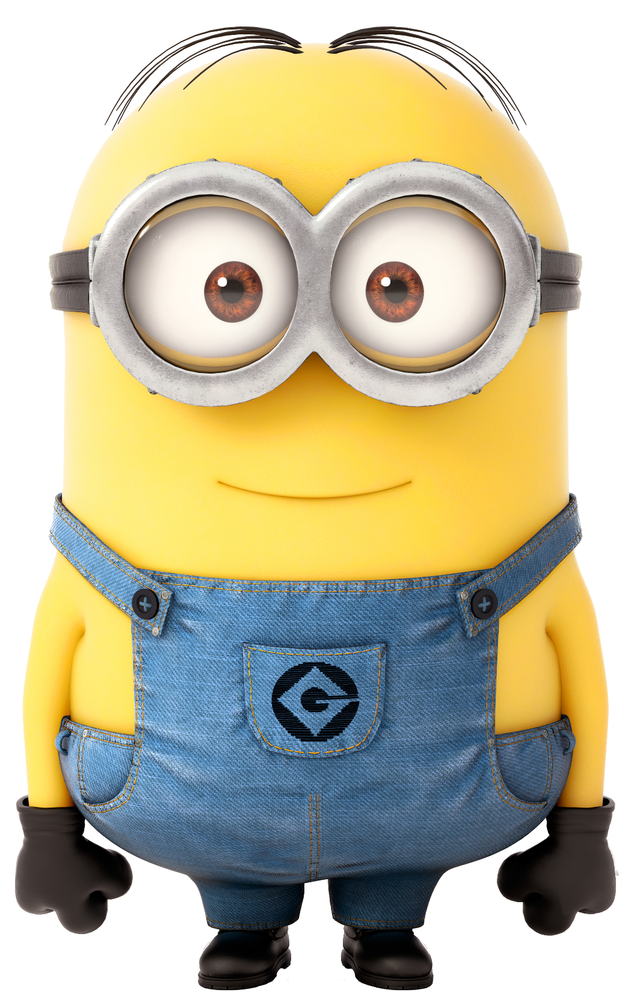

15%
TITLE HERE
Kevin and Bob are recruited by Scarlett Overkill, a super-villain who, alongside her inventor husband
Herb, hatches
a plot to
take over
the world.

Slide 17
TITLE HERE
TITLE HERE
Kevin and Bob are recruited by Scarlett Overkill, a super-villain who, alongside her inventor husband Herb,
Kevin and Bob are recruited by Scarlett Overkill, a super-villain who, alongside her inventor husband Herb,
TITLE HERE
MINIONS
Kevin and Bob are recruited by Scarlett Overkill, a super-villain who, alongside her inventor husband Herb, hatches a plot to take over the world.
Kevin and Bob are recruited by Scarlett Overkill, a super-villain who, alongside her inventor husband Herb,

Slide 18
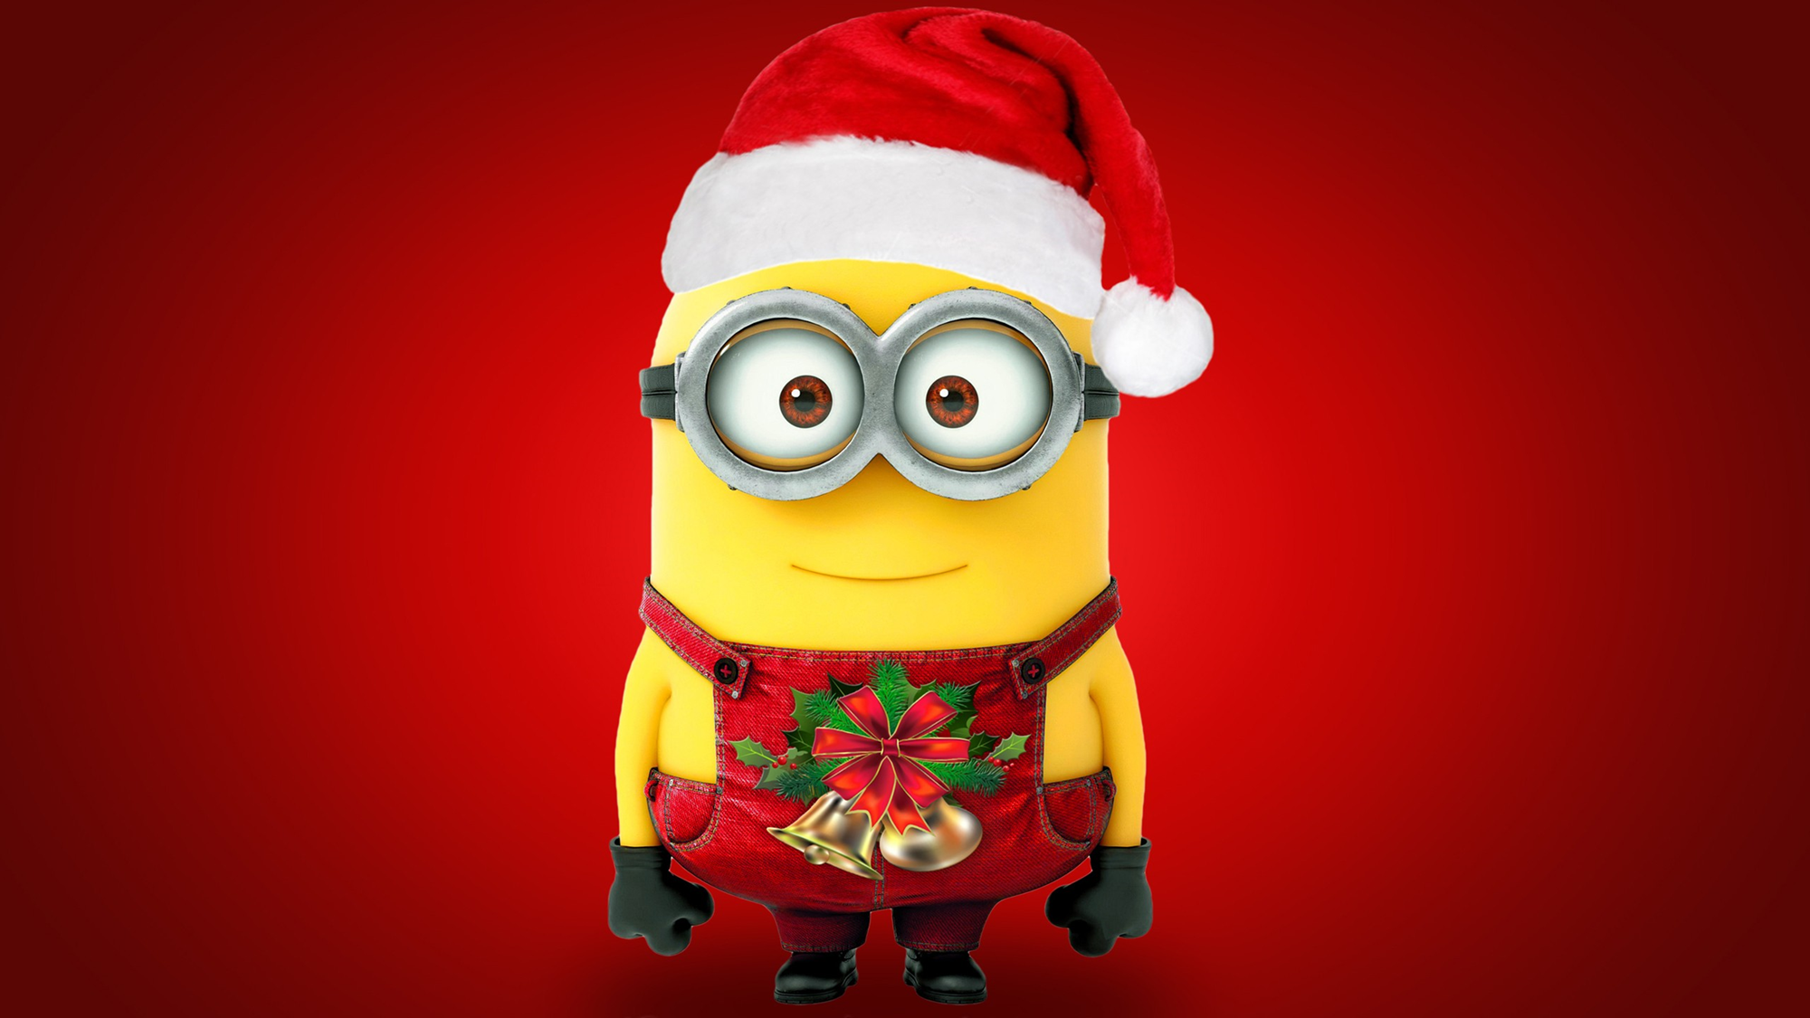

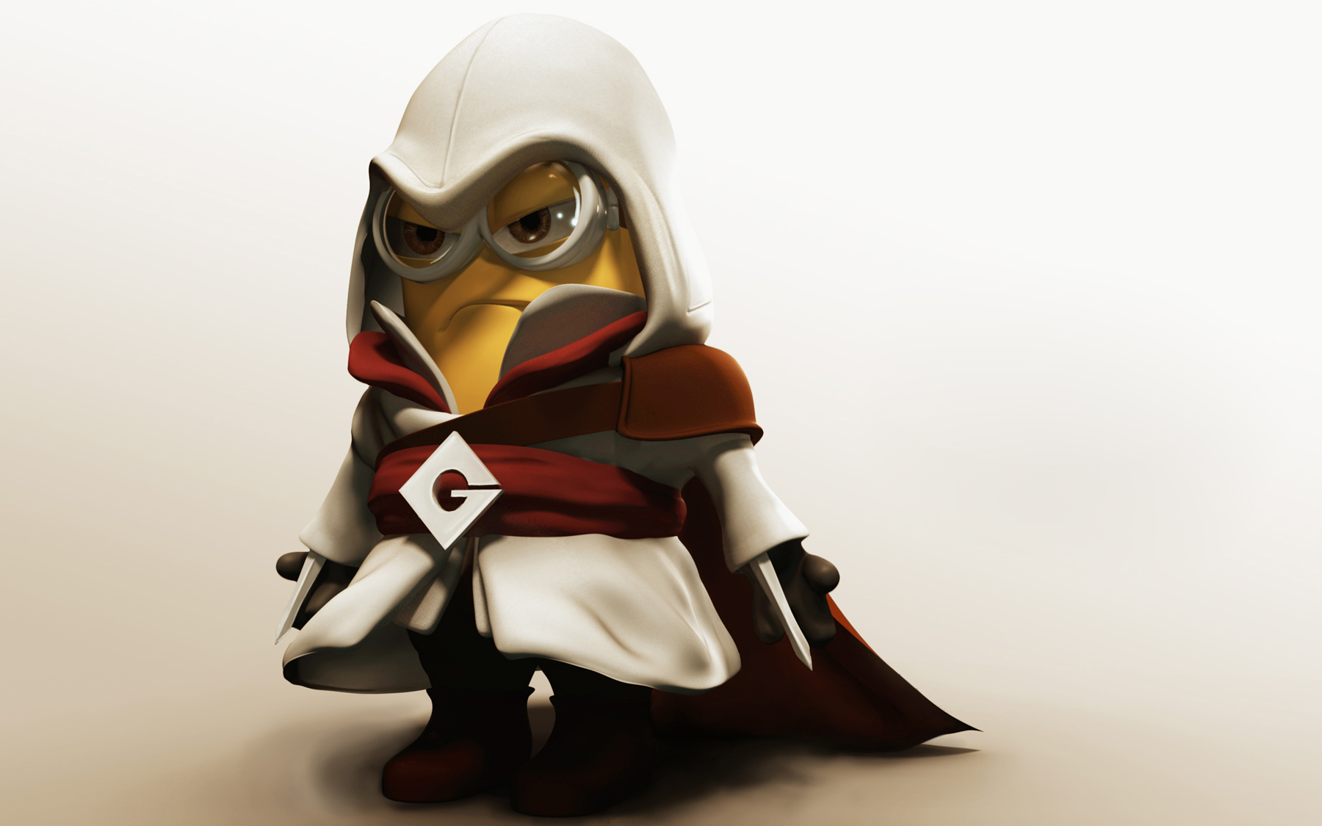
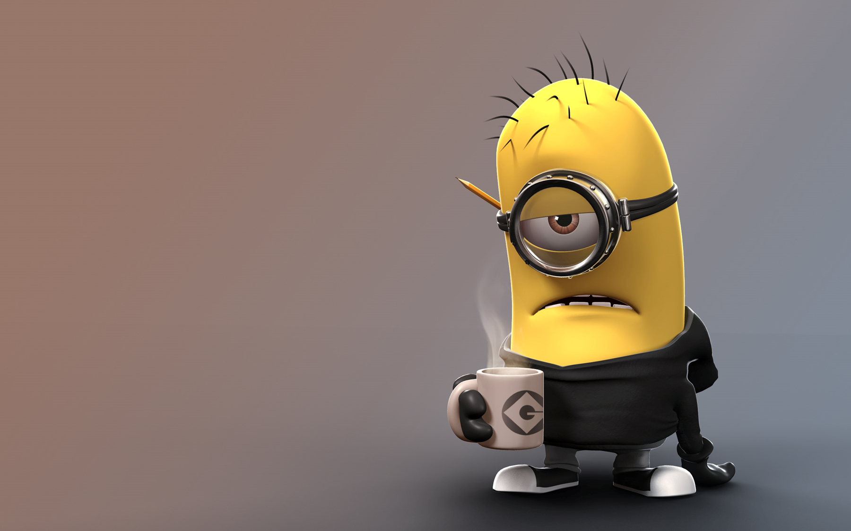
MINIONS
Kevin and Bob are recruited by Scarlett Overkill, a super-villain who, alongside her inventor husband Herb, hatches a plot to take over the world.
Kevin and Bob are recruited by Scarlett Overkill, a super-villain who, alongside her inventor husband Herb, hatches a plot to take over the world.
Kevin and Bob are recruited by Scarlett Overkill, a super-villain who, alongside her inventor husband Herb, hatches a plot to take over the world.

Slide 19
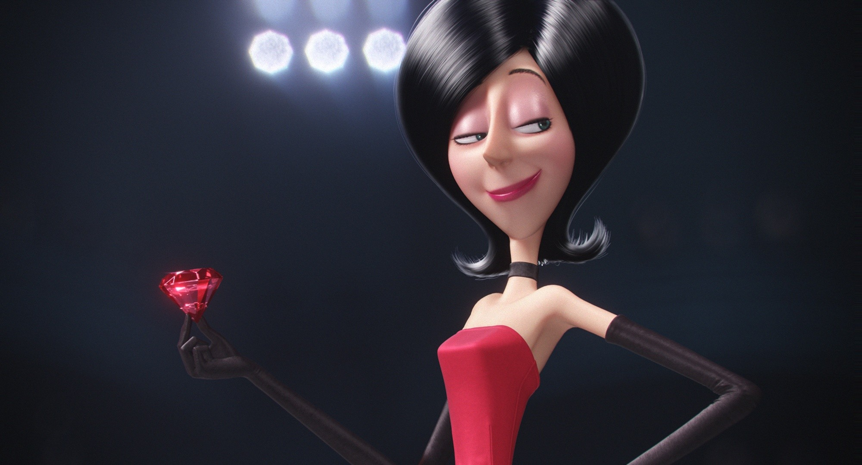
Scarlett Overkill
Scarlett Overkill
Kevin and Bob are recruited by Scarlett Overkill, a super-villain who, alongside her inventor husband Herb, hatches a plot to take over the world.

Slide 20
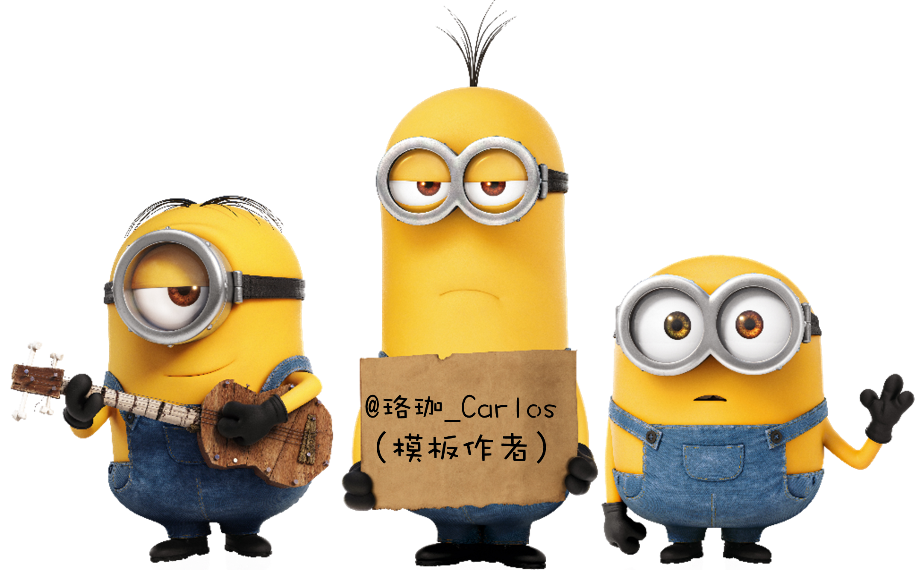
TANK YU!
LUOJIA DESIGN
(THANK YOU)

Slide 21
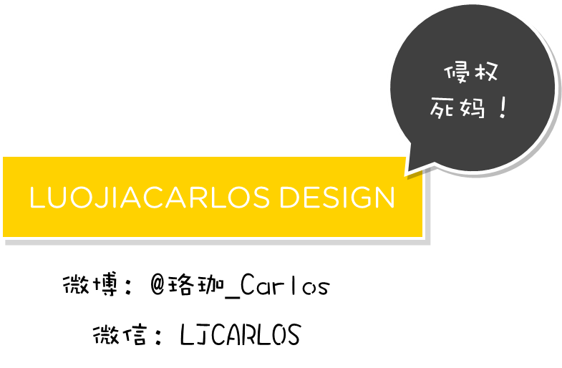

Slide 22
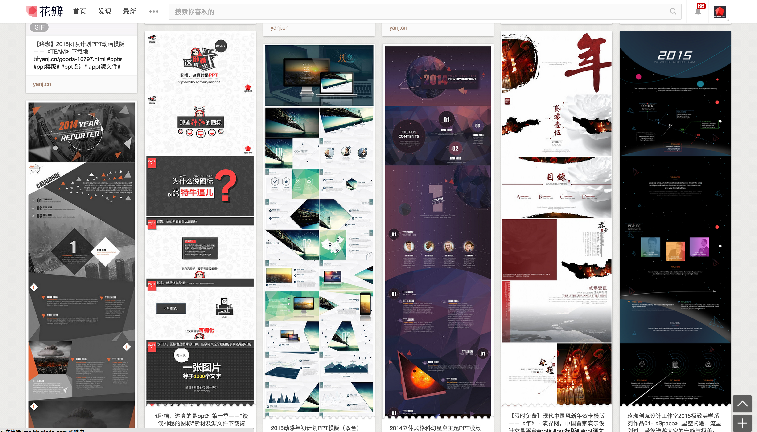
如果你喜欢珞珈的作品，欢迎光临：
http://luojia.yanj.cn/

Slide 23
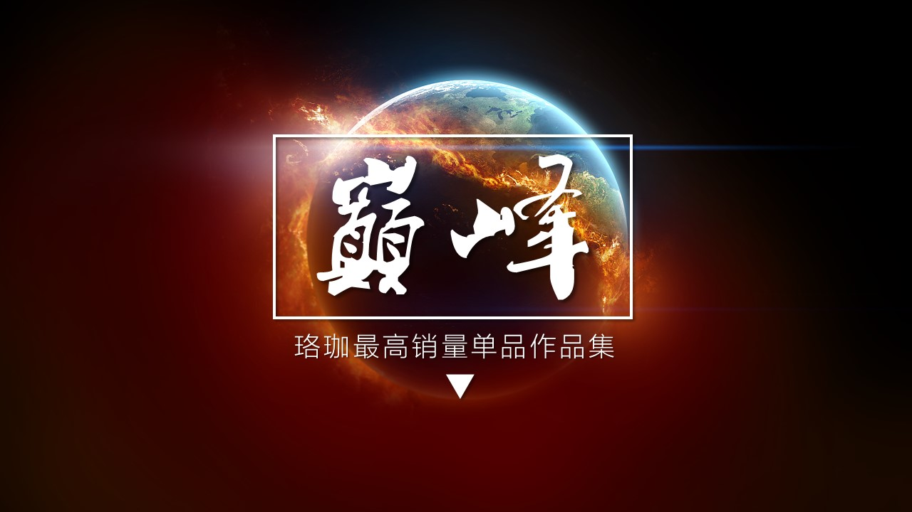
收费下载地址：http://luojia.yanj.cn/goods-18663.html

Slide 24
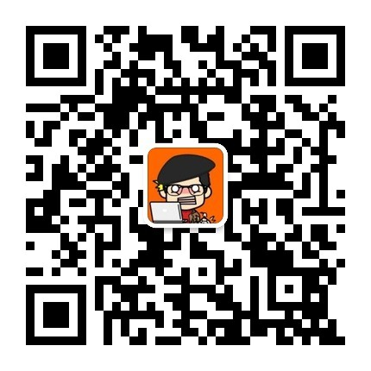
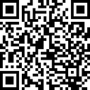
如果你喜欢珞珈的教程，欢迎关注：
微信
微博

Slide 25
51PPT模板网 www.51pptmoban.com 授权发布

